Slide 1
Webtop Automation - Handover
By Vivian Wang
2015.9

Slide 2
Handover List
--------- Part A--------------------------
Webtop basic to new comer
Installation
--------- Part B--------------------------
Robot Framework
Case Design Logic
Test Scope and coverage
Script Structure
--------- Part C--------------------------
Work Flow
Report method

Slide 3
Webtop Basic to New comer

Slide 4
Webtop API
From End User site
Webtop
API
handle the HTTP request in server layer
return the response to client site
QA/UI
Browser
Client
Webtop
App servers
Webtop
App servers
Nginx
Scality Cassandra
etc.
Backend

Slide 5




Scope
Webtop is a connection between users and app servers
Webtop
App servers
Contacts
Calendar
Tasks
Settings
Mails
Client -> Webtop -> app servers

Slide 6
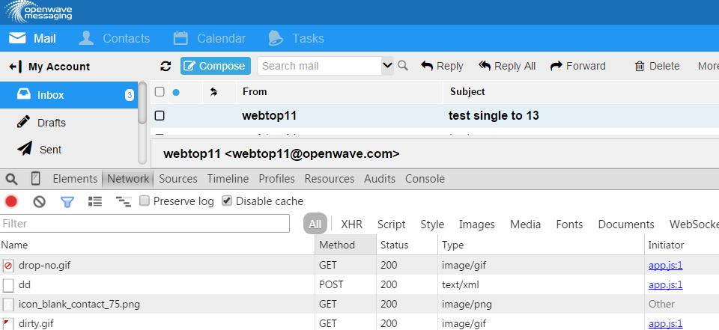
Webtop API
HTTP request: Webtop only focus on POST input

Slide 7
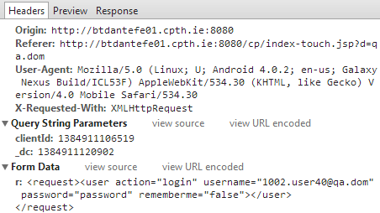
Webtop API
POST request - XML

Slide 8
Webtop API
POST response – XML
<response tokenExpiry="1259810" sessionId="EbrEnwSE-13" token="dd8e2528f8dfa97dda84faafdd99cec0042f6a71cc574ba91e11632b68c73005d700be252ae49df0c6ed18703d87b198e67585d360d8c0e5e5c7a3fd92fdfc84">
<user action="login">
<common><string_userId value="1002.user40@qa.dom" /><string_userName value="1002.user40@qa.dom" /><string_userFullName value="1002.user40@qa.dom" /><string_userEmail value="1002.user40@qa.dom" /></common><contacts><number_maxGroupSize value="50" /><number_maxContactFields value="20" /><number_maxContactListEntries value="300" /></contacts></user></response>

Slide 9
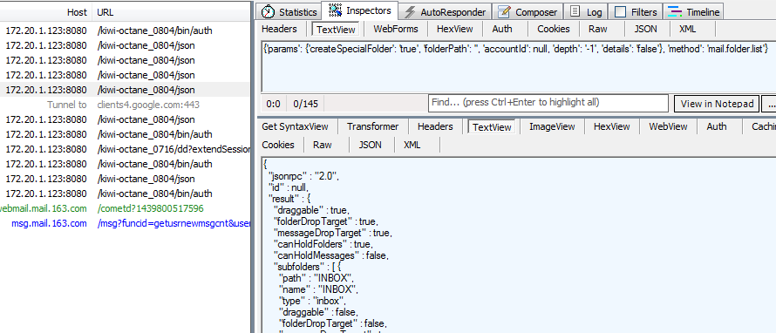
Webtop API
POST - JSON
Request
Response

Slide 10

Webtop API
Real Front-end:
Most features are still using XML requests
Request is sent by browser
Catch request by both browser development plug-in and 3rd party tools (like Charles, Fiddler)
Webtop automation test:
Both XML and JSON requests
Request is sent by codes
Catch request by 3rd party tools, recommand: Charles, Fiddler, browser
The other way to check request is to use “advance rest client” for Chrome, or “Post man” for Firefox

Slide 11
Webtop API
Webtop code version
Webtop accept both XML and JSON on any version
For SBM – only focus on XML
Fusion - 4.0.2.xx
4.0.2.xx
JSON is under developing, but there’s not any test
SBM and Fusion share same code
4.2.0.22
Master branch
For Fusion
4.2.0.1
focus on JSON
focus on both JSON and XML
Big change:
Login authentication
Update login to JSON

Slide 12
Installations

Slide 13
Installation
Script Language
python 2.X (recommand Python 2.7.x)
(Only for robot script) Python 3rd party lib: requests, pytz, Crypto, poster,
Tools
Install tools like Python easy_install
wxPython
Robot Installation
Robotframework - Robot
robot Ride – Robot GUI
Other for Jenkins or Jenkins server:
Python 3rd party: Xlrd, xlwt – read and write excel report
Selenium – start Scality ring from web page
Enclosed readme contains the current
version of installation softwares,
But I suggest to follow the latest robot framework official instructure to avoid the gap of all softwares

